Slide 1
Azure Functions
Everything you need to know to get started

Slide 2




Ganesh Tiwari
Master of Computer Science Student,
Loves Programming with Python, Kotlin and Dart, Plays Minecraft a lot.
ganeshtiwari786
Linkedin.com/in/gat786
@iwrotestan

Slide 3
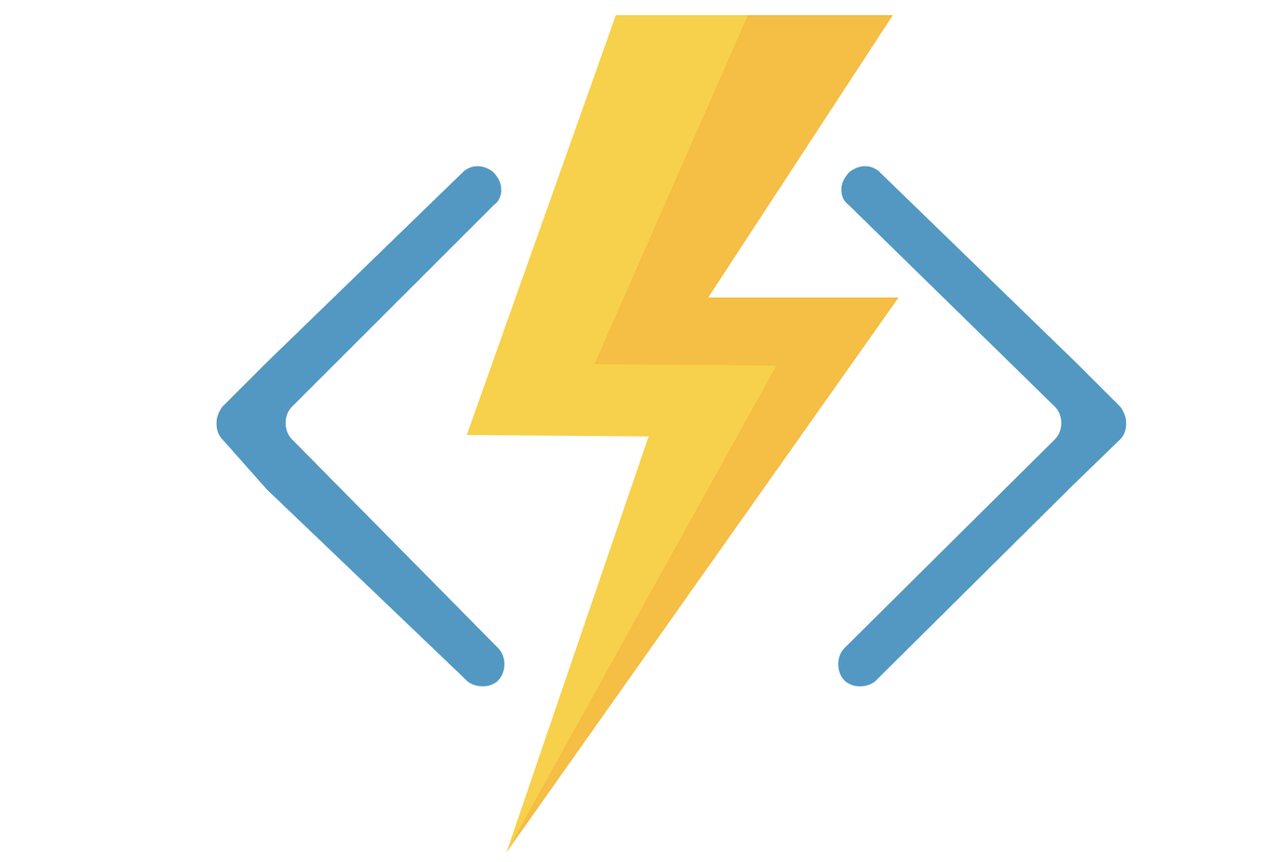
What is Azure Functions?
Azure Functions is an event driven, compute-on-demand experience that extends the existing Azure application platform with capabilities to implement code triggered by events occurring in Azure or third-party service as well as on-premises systems.
Azure Functions Logo

Slide 4
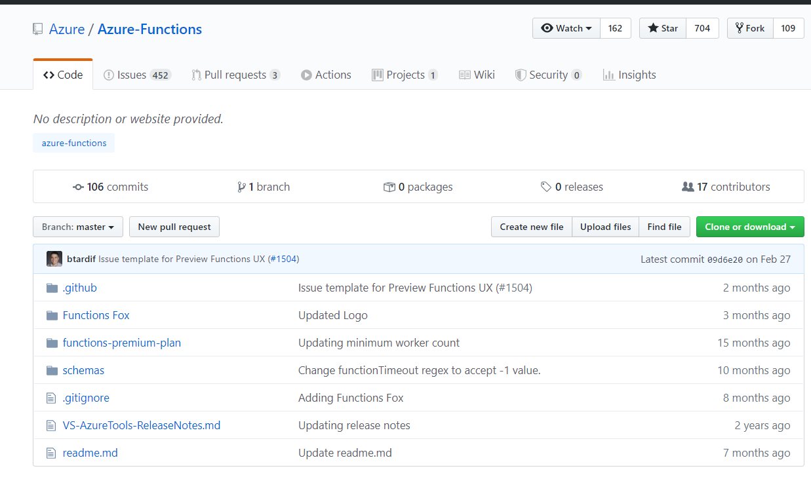
How does it work?
A robust developer experience
A wide range of triggering options
An innovative way of accessing and processing data
“Serverless” execution model
Open source runtime that runs anywhere
Azure Functions Github Page

Slide 5
Bindings and Triggers
Blob storage
Cosmos DB
Event Grid
Event Hubs
HTTP & webhooks
IoT Hub
Microsoft Graph Excel tables
Microsoft Graph OneDrive files
Microsoft Graph Outlook email
Microsoft Graph events
Microsoft Graph Auth tokens
Mobile Apps
Notification Hubs
Queue storage
SendGrid
Service Bus
SignalR
Table storage
Timer
Twilio

Slide 6


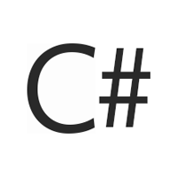



Which languages are supported?
C#
Java
Javascript
Powershell
Python
Typescript

Slide 7
DEMO TIME YAY!

Slide 8
Thanks for listening to Gat786 ♥
Have Fun Stay Safe and take care of yourself.

